Slide 1
Text Classification on Emails
Fatima, Neha, Bev, Veronika and Sibtain

Slide 2
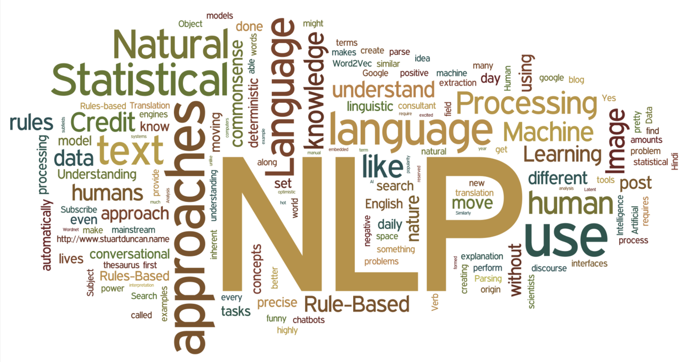
Why Text Classification on Emails?
Text classification has wide variety of applications in various domains.
It can be used in cyber security for classification of documents on the basis of privacy and confidentiality.
It can be used for sentiment analysis for customer reviews in online shopping etc.

Slide 3
Machine Learning Model
We intend to perform text classification and use Latent Dirichlet Allocation algorithm. It is an exploratory process and LDA identifies the hidden topic structures in text documents. It uses Bayesian statistics and Dirichlet distributions for processing and identifying the topics.
We can use the following classification algorithm, along with LDA:
KNN
Logistic Regression

Slide 4
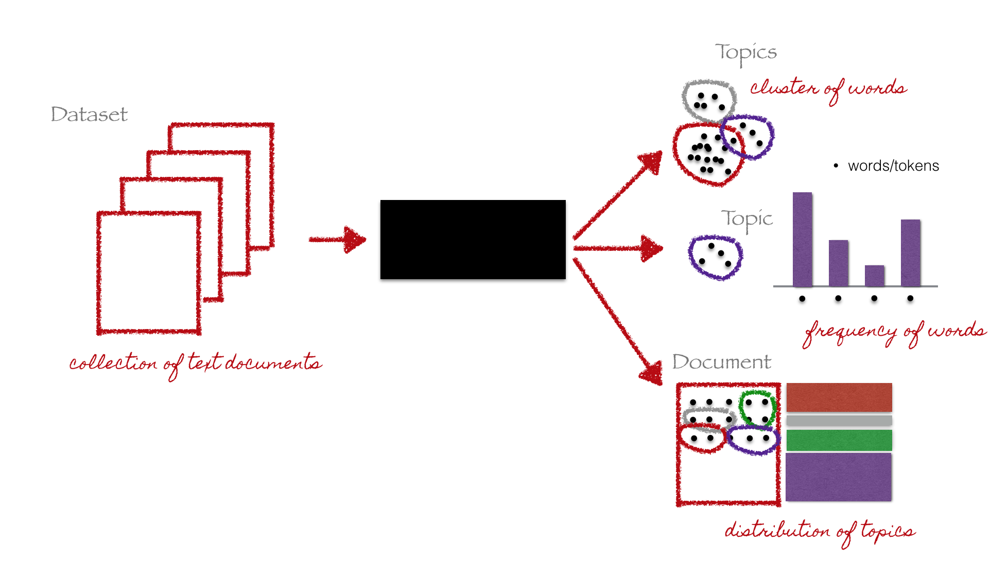
Latent Dirichlet Allocation (LDA) algorithm
LDA black box
We performed data cleaning before applying LDA model.

Slide 5
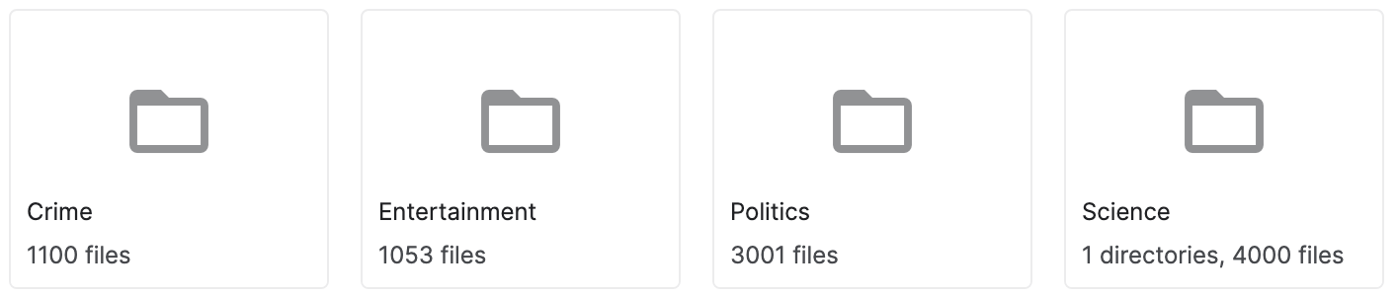
Description of Source of Data
Text Classification on Emails dataset contains email exchanges among journalists with labeled data.
Data provided by the editor of a newspaper
Labelled folders with text files which are unstructured data
The text files are labelled in multiple folders:

Slide 6
Questions we hope to answer with the data
Purpose:
Perform text classification on email data and categorize data into four categories; crime, politics, science and entertainment. This problem falls under “Topic Modeling”.
Whether machine learning provides a sufficient accuracy level for predicting topic classification on unseen text.

Slide 7
Description of Data Exploration Phase
We reviewed a sample of the emails; txt files.
No statistical methods were used to analyze the data.
Size was determined to be an issue, therefore, Colab was used for transforming the data.

Slide 8
Description of Analysis Phase
Prior to text classification, LDA pre-process the raw text/document.
Normalization: Transform text to normal/canonical form
Stemming: reduce a word to its word stem/root without suffixes and prefixes
Stopwordremoval: remove words that do not add any logical meaning.
Lemmatization: Words in third person are changed to first person and verbs in past and future tenses are changed into present
Tokenization: Break text into ‘tokens’, i.e. Words and phrases. Split the text into sentences and the sentences into words. Lowercase the words and remove punctuation.

Slide 9
Data Preprocessing
We performed data cleaning before applying LDA model, and performed the following steps:
Raw data was available in txt files and we created dataframe for all of the data and stored in google Colab.
Stop words are removed and data is lemanized and tokanized. Imported “stopwords” from nltk.corpus, “WordPunctTokenizer” from nltk.tokanize, “punctuation” from string, and WordNetLemmatizer from nltk.stem.
Cleaned data is stored in the same dataframe with column name “Filtered Text”

Slide 10
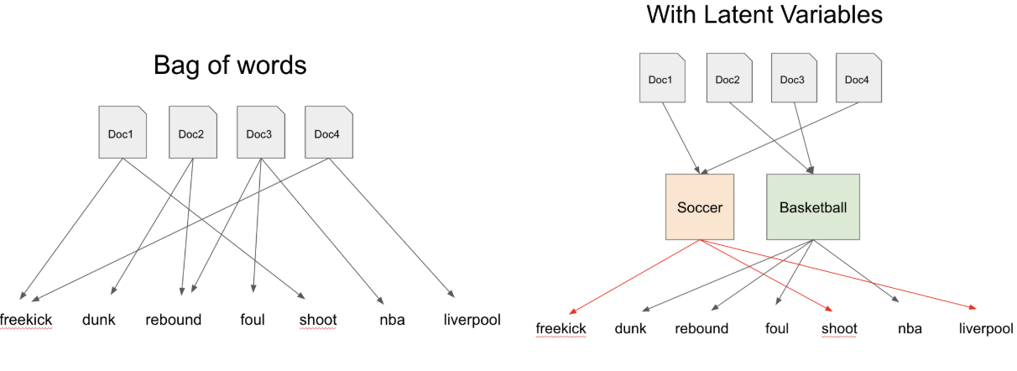
Data Preprocessing Bag of Words
Before applying the LDA model, we developed the “Bag of Words” from the “Filtered Text” column:
Entire sentence is split on spaces and words are separated.
Dictionary of words is created by importing “gensim” and “simple_preprocess” from gensim.utils
Each word will be shown by number of times it appears in the dictionary

Slide 11
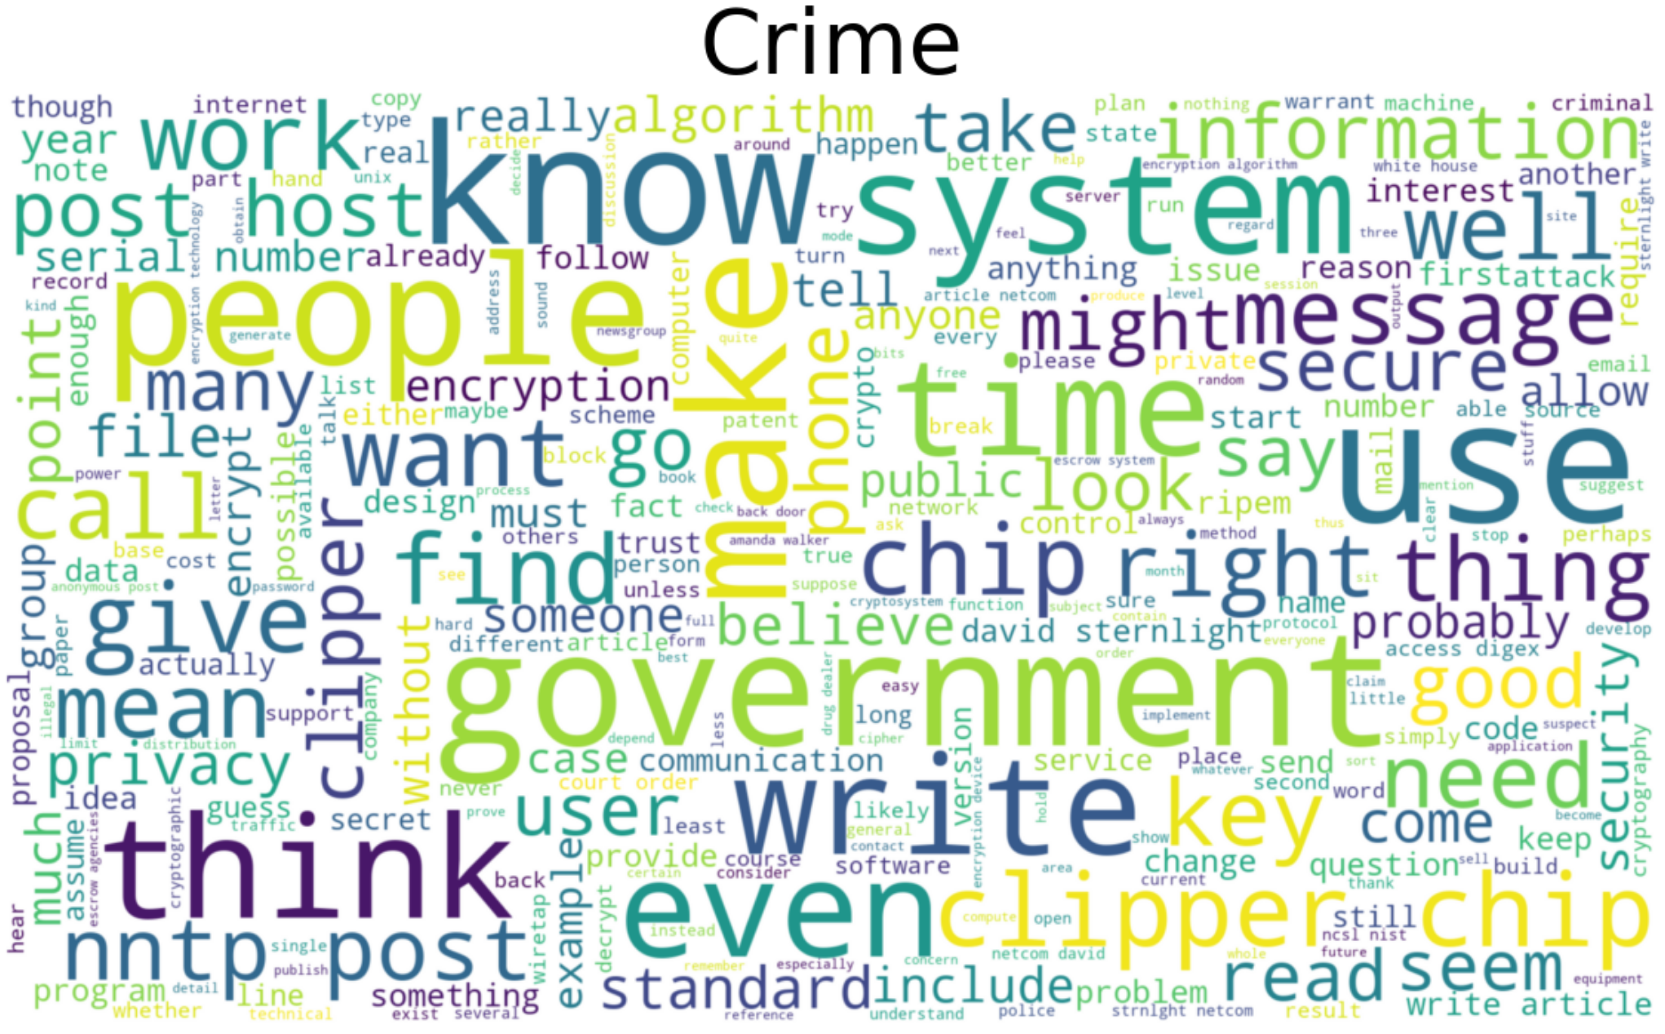
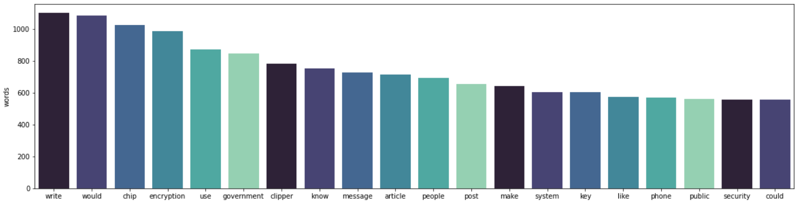
Crime class:
Wordcloud
& top 20 words

Slide 12
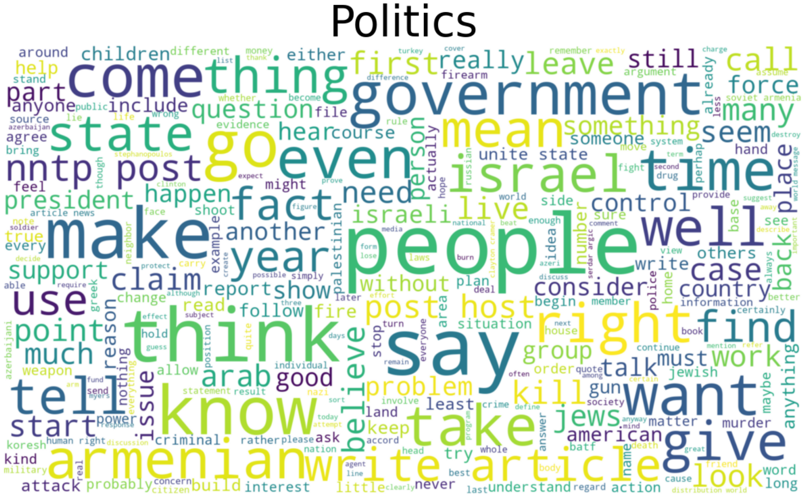
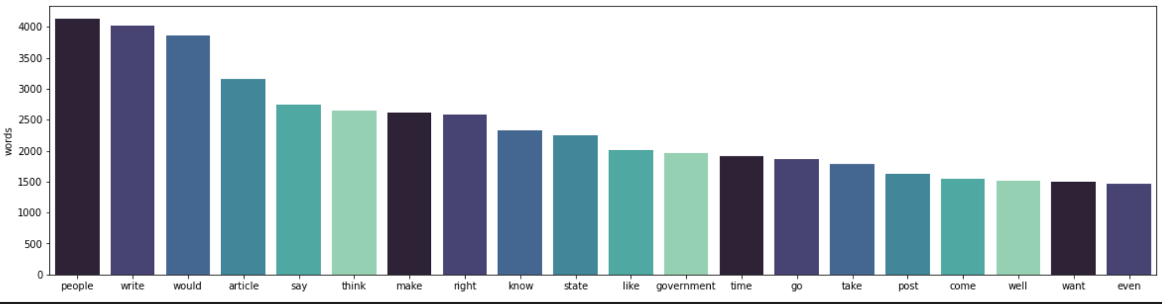
Politics class:
Wordcloud
& top 20 words

Slide 13
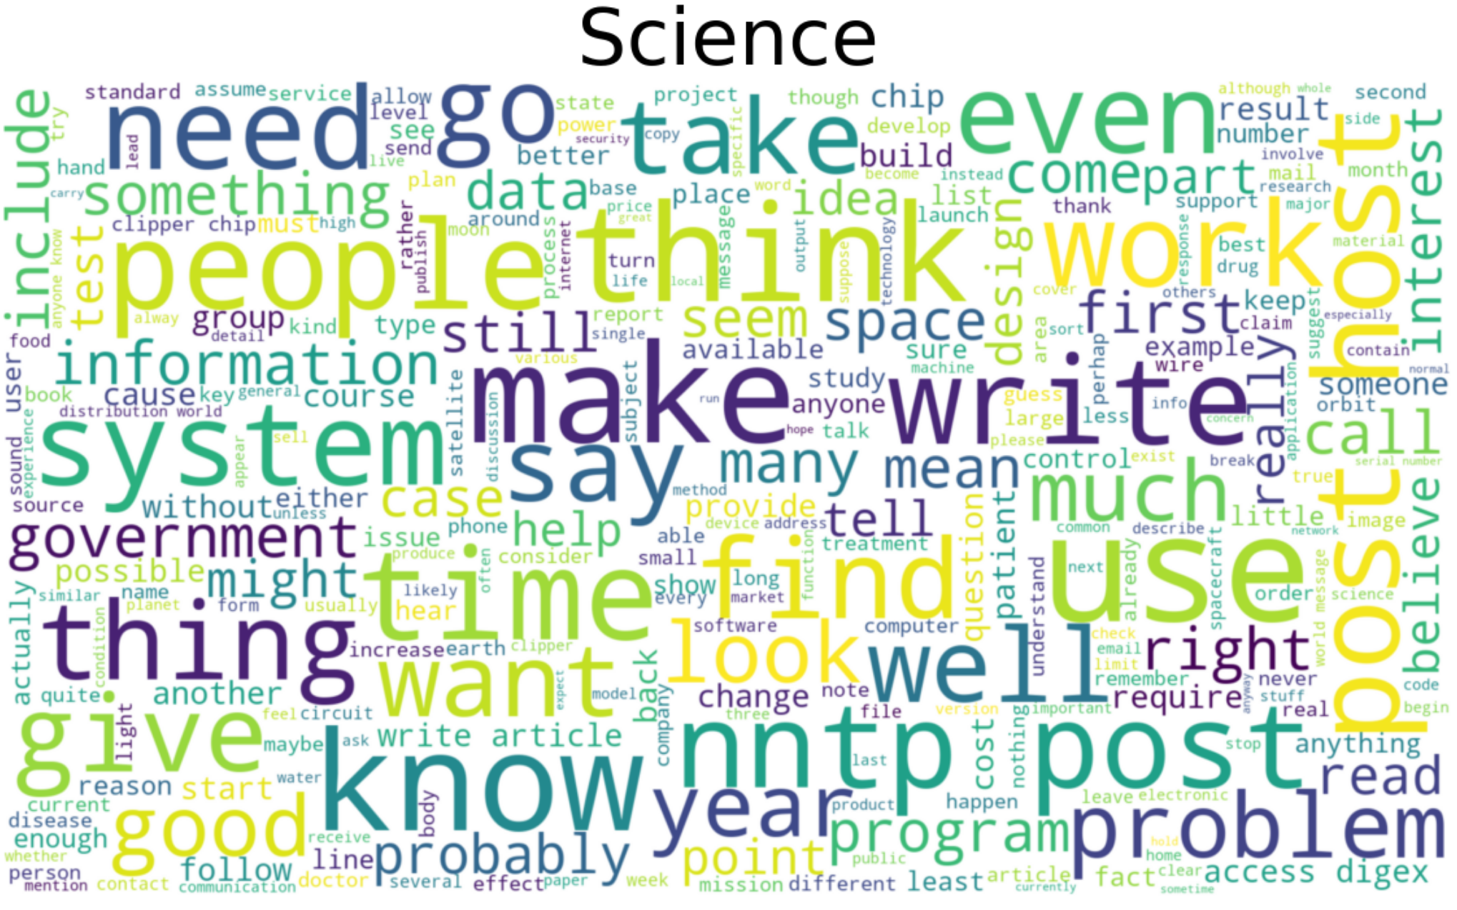
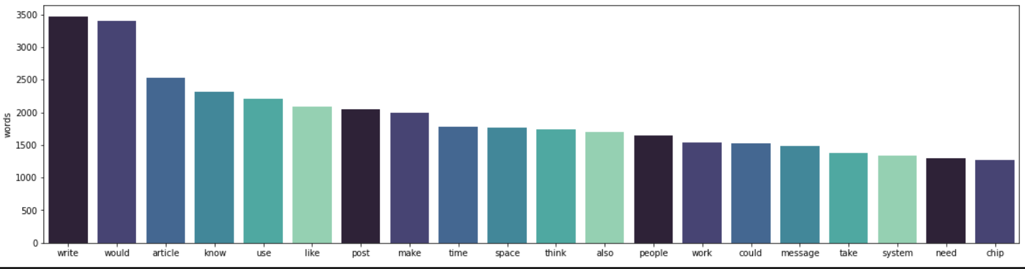
Science class:
Wordcloud
& top 20 words

Slide 14
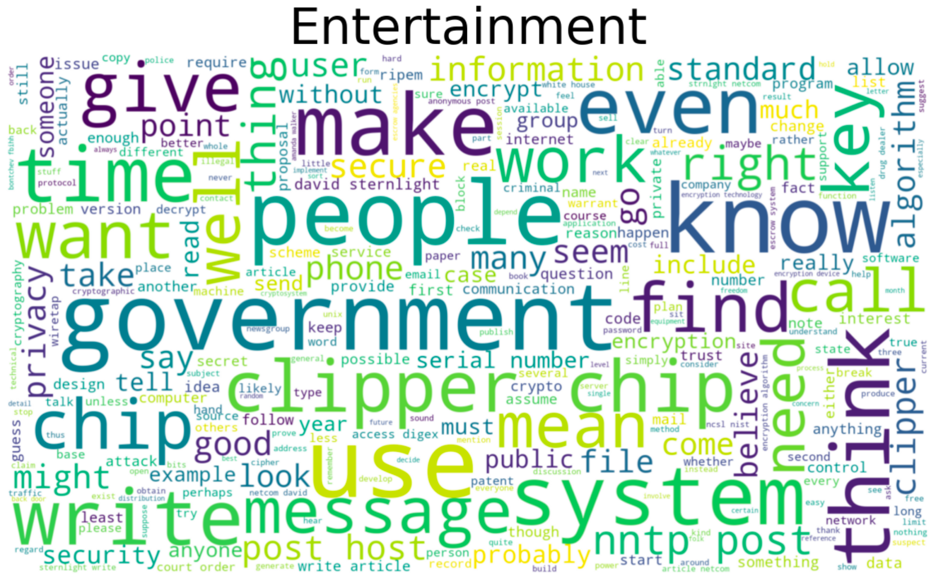
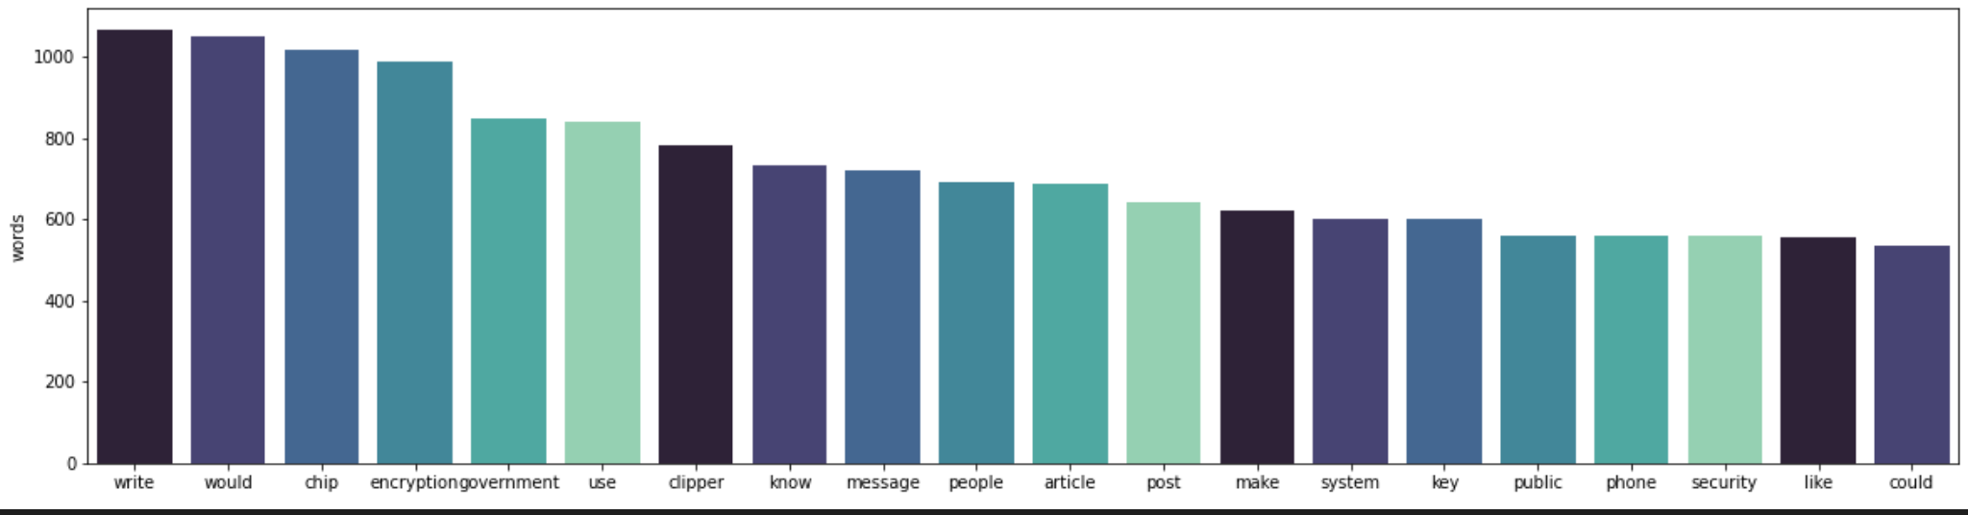
Entertainment class:
Wordcloud
& top 20 words

Slide 15
Model Details
LDA Model
We used: lda_model = gensim.models.LdaMulticore(corpus, id2word=id2word,num_topics=num_topics) to build the model and tried with different number of topics.
We see distinct clusters when we choose “No. Topics=4”. If “No. Topics” are increases, intersecting clusters are formed, clearly showing that data set has distinct four categories of text.
We used pyLDAvis.gensim to see the visuals.

Slide 16
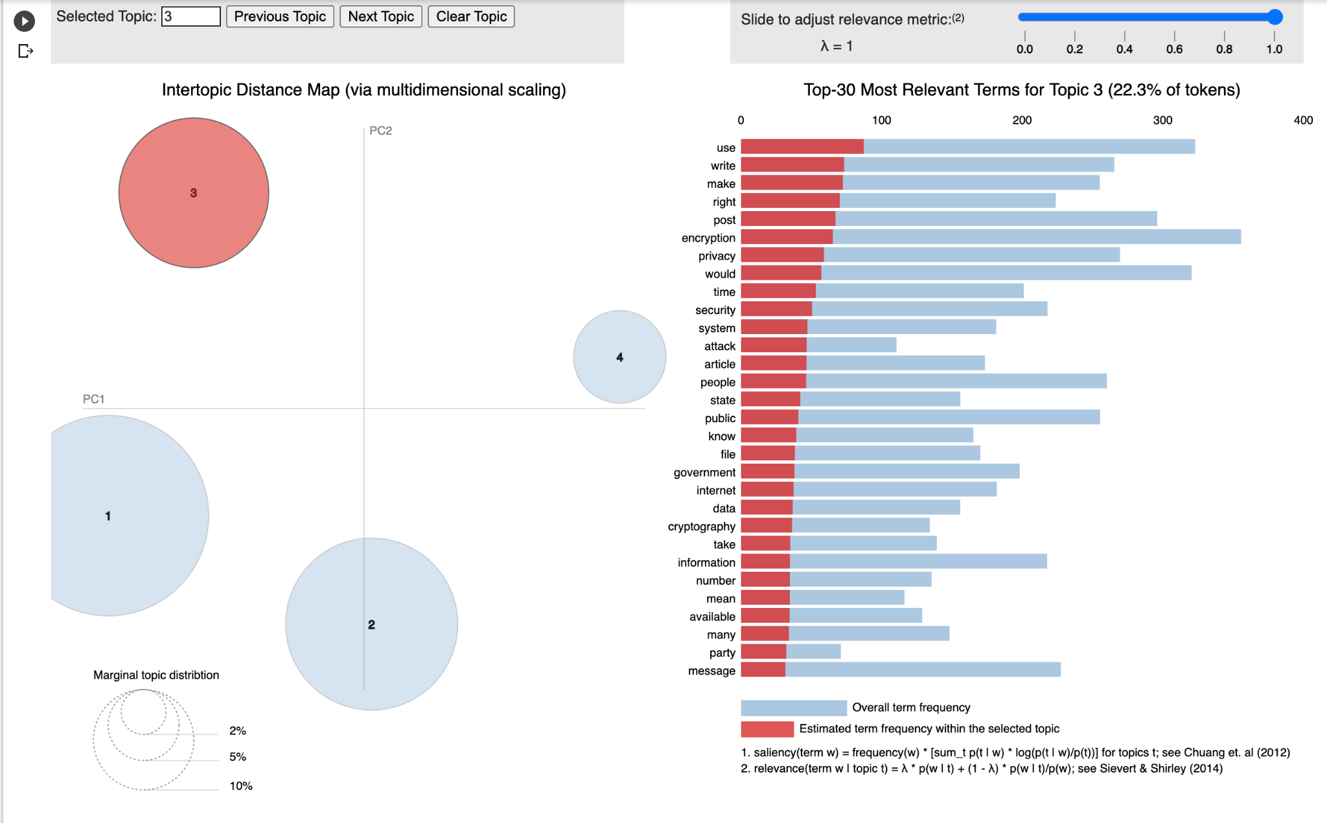
LDA with four distinct topics versus LDA with two overlapping clusters

Slide 17
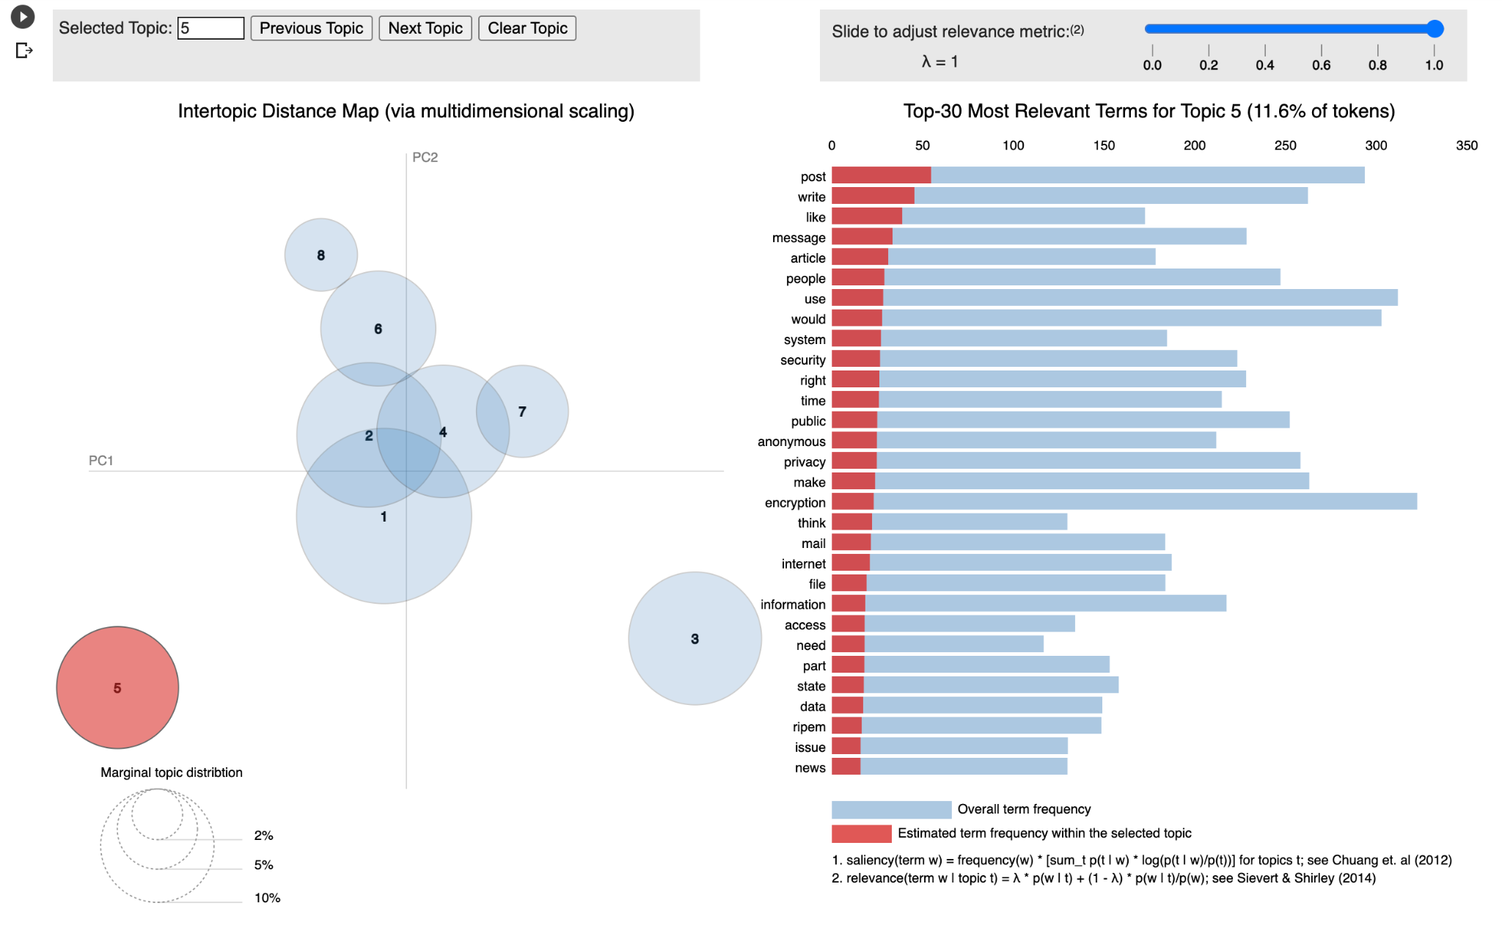
LDA with four distinct topics versus LDA with two overlapping clusters

Slide 18
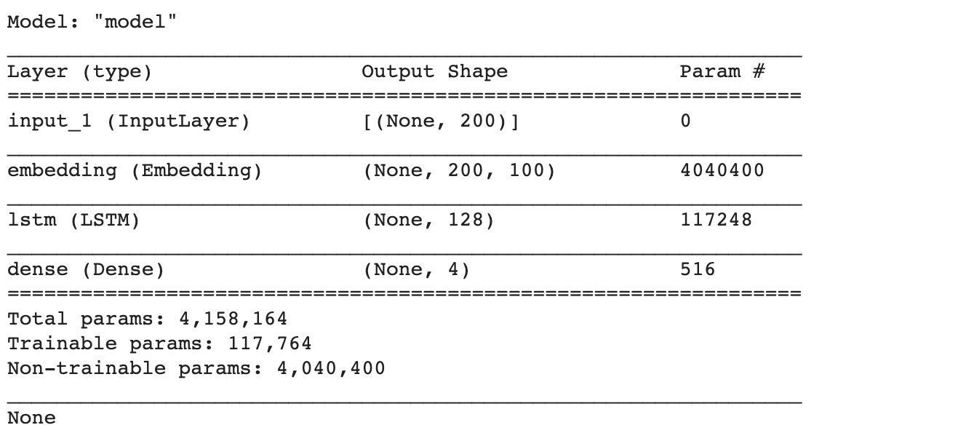
Multi-Class Neural Network
Initial Accuracy: 28 %
Changed the Sigmoid to Softmax in the final layer
Increased the number of layers
Added embedding layer
Increased the number of epochs
Final Accuracy: 58 %

Slide 19
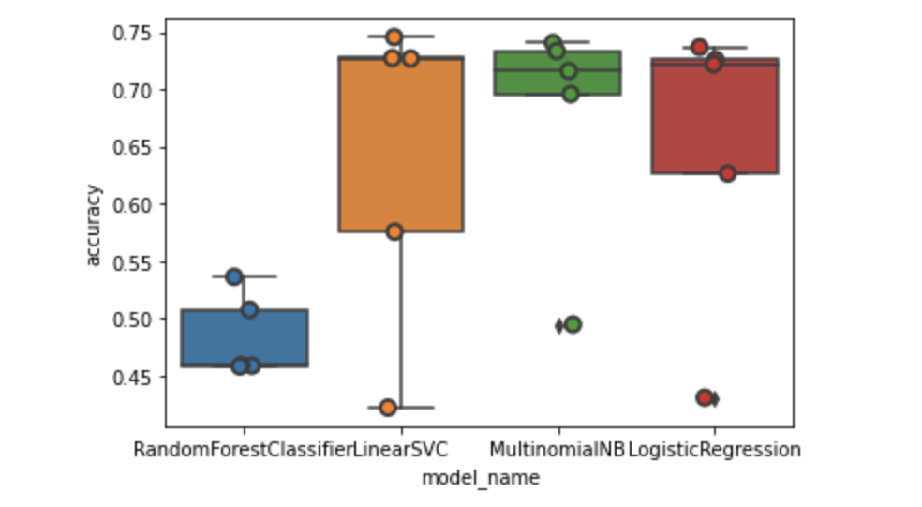
Multi-Class Supervised Models
Multinomial Naive Bayes
Logistic Regression
Linear Support Vector Machine
Random Forest
We compared the accuracy of 4 classifiers and found Multinomial Naive Bayes to best with accuracy of 67%, Random Forest with worst accuracy if 48%. While, linear SVM and Logistic Regression showed almost the same accuracy of 63% and 64%, respectively.

Slide 20
Comparison
LDA model gives the percentage relevance of a test data to the topic it belongs to.
NB model give the exact category of test data.
Usability of each model depends on the use case

Slide 21
Where (problems)?
Whats next?
Familiarize with various libraries
Difficult to quantify the parameter, to improve the accuracy of NN
Will use pooling layers to improve the accuracy of the NN

Slide 22
Storyboard

Slide 23
Purpose - Webpage
Provide summary of the machine learning models
Provide a text box where the user can input an email and then submit
Machine Learning model will classify the email
Result will show the classification of the email based on each model
Confidence will show the confidence of the classification for each model
User will be able to clear the text box and enter new text

Slide 24
Questions
Other than the input and output of the classification what else do we want to display? If anything else do we want a separate page.
Is there an overall color scheme we want?
Where will we host the webpage?

Slide 25
Tools - Webpage
TBD - server options
Flask - will house the machine learning models (h5 files), once a user enters text in the input box, Flask will apply the machine learning models to the text and show the results in separate panes.
HTML, Bootstrap 4, and CSS stylesheet - will provide the look and feel of the webpage.
TBD - integration of Tableau dashboards

Slide 26
Webpage - Homepage
Title (jumbotron to be used)
General description of models; include links 2 separate web pages for each model.
Input Text for Classification
Input box
Predict
Clear
Home
Model | Class | Probability
Model 1 | Results | Results
Model 2 | Results | Results

Slide 27
Webpage (1 and 2) - Models
Model 1(jumbotron to be used)
Details of the model used.
Visuals from model training
Visuals from model training

Slide 28
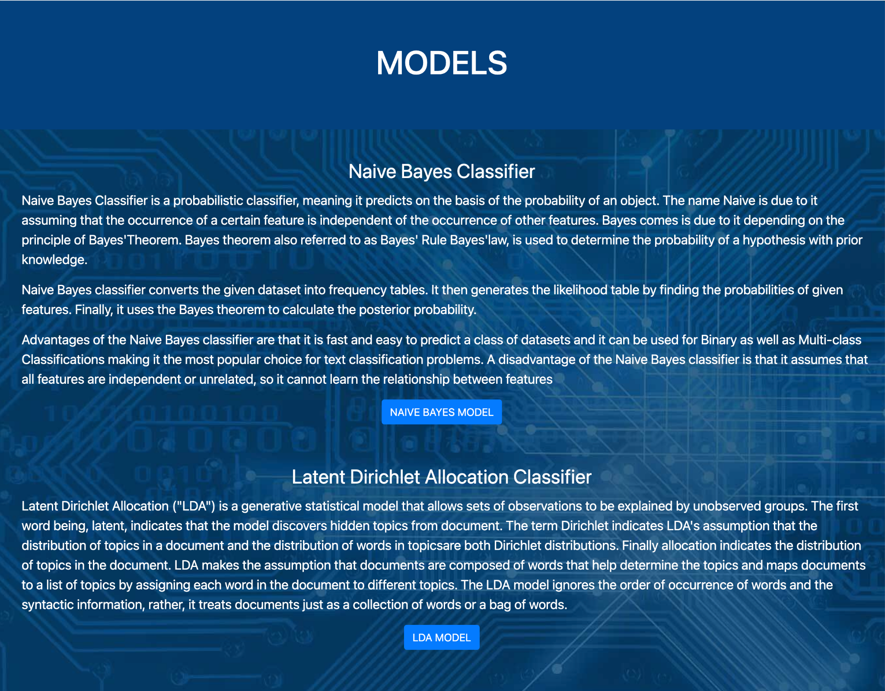
Text Classification on Emails home webpage

Slide 29
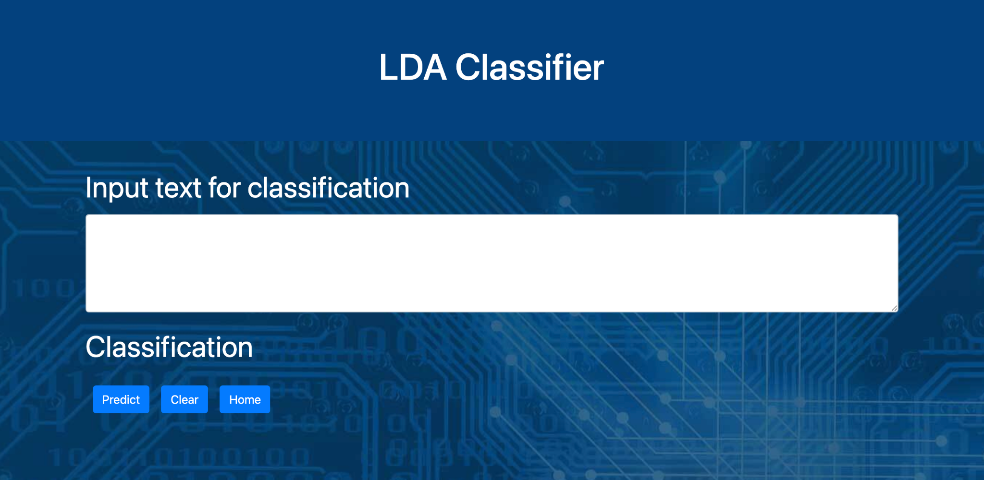
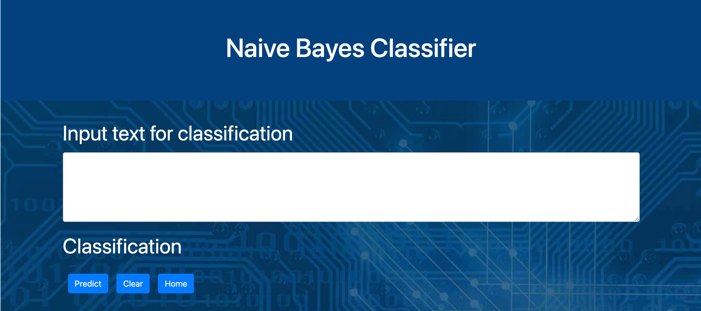
Latent Dirichlet Allocation Model
Naive Bayes Model

Slide 30
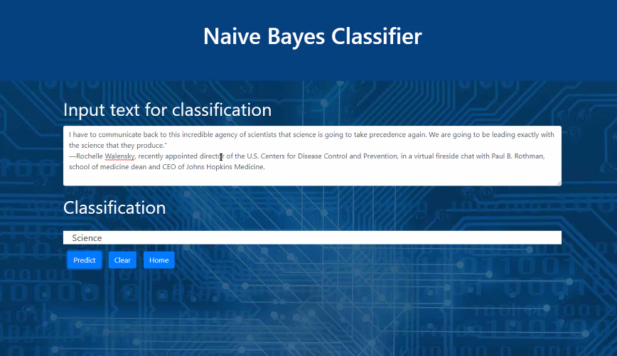
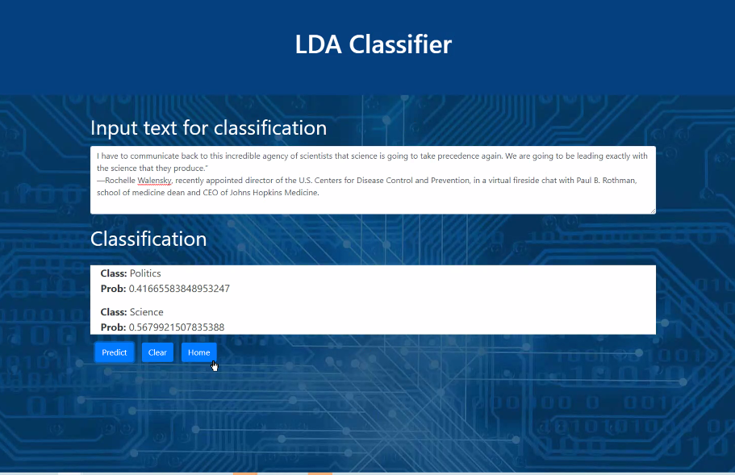
Results on the webpage

Slide 31
References
https://stackabuse.com/python-for-nlp-multi-label-text-classification-with-keras
https://towardsdatascience.com/multi-class-text-classification-with-scikit-learn-12f1e60e0a9f
https://sci2lab.github.io/ml_tutorial/multiclass_classification/#Random-Forest
https://stackabuse.com/python-for-nlp-multi-label-text-classification-with-keras
https://github.com/kapadias/mediumposts/blob/master/natural_language_processing/topic_modeling/data/NIPS%20Papers.zip
Emails Dataset (https://www.kaggle.com/dipankarsrirag/topic-modelling-on-emails
Github
https://github.com/bholeneha/Text_Classification

Slide 32
Thank you!

